Slide 1
CAPSTONE PROJECT
FANDANGO MOVIE RATING VS TRUE USER RATINGS DISCREPANCY ANALYSIS USING PYTHON
Presented By:
1. SunilKumar.M - Paavai College of Engineering - EEE

Slide 2
OUTLINE
Problem Statement
Proposed System/Solution
System Development Approach
Algorithm & Deployment
Result
Conclusion
Future Scope
References

Slide 3
PROBLEM STATEMENT
Despite the critical role of movie ratings in influencing consumer choices, there is a growing concern about the authenticity and reliability of these ratings. This project aims to investigate the potential discrepancy between the movie ratings displayed by Fandango and the true user ratings. Utilizing Python, a popular programming language known for its robust data analysis libraries, we will systematically collect, process, and analyze the data to uncover any significant differences. The goal is to determine whether Fandango’s displayed ratings are consistently higher than the actual user ratings, and if so, to quantify this bias and explore its implications for consumers and the broader movie industry.

Slide 4
PROPOSED SOLUTION
Data Collection: Use Python libraries like requests and BeautifulSoup to scrape Fandango’s website for movie ratings and user reviews.
Data Processing: Clean and preprocess the data using pandas. Normalize rating scales if necessary.
Exploratory Analysis: Employ matplotlib and seaborn for visualizing the data to identify any initial patterns or discrepancies.
Statistical Analysis: Apply statistical methods with scipy or statsmodels to test for significant differences between displayed ratings and user ratings.
Machine Learning: Optionally, use scikit-learn to model the relationship between Fandango’s ratings and user scores.
Documentation: Document the analysis process, code, and findings in a Jupyter Notebook for transparency and reproducibility.
Reporting: Summarize the insights and present the conclusions in a clear, accessible format, possibly using Dash or Flask for an interactive web report.

Slide 5
SYSTEM APPROACH
Building the proposed solution would involve a combination of data processing, feature engineering and machine learning. Here are the key system and library requirements:
System Requirements:
Hardware:
Processor: Intel i5 or equivalent.
Memory: 8GB RAM minimum.
Storage: At least 20GB of free disk space.
Software:
Operating System: Windows, macOS, or Linux with Python support.
Python Version: Python 3.7 or higher.

Slide 6
SYSTEM APPROACH - CONT
Library Requirements:
Pandas for data manipulation.
Numpy for numerical operations.
Matplotlib and Seaborn for data visualization.
Scipy or Statsmodels for statistical analysis.

Slide 7
ALGORITHM & DEPLOYMENT
Algorithm Selection
Data Exploration:
Descriptive Statistics: Use pandas to calculate mean, median, mode, range, and standard deviation.
Data Visualization: Employ matplotlib and seaborn for creating histograms, box plots, and scatter plots to visualize the data distribution and identify outliers.
Correlation Analysis: Utilize pandas or numpy to calculate Pearson or Spearman correlation coefficients between Fandango ratings and user ratings.
Problem Formulation:
Hypothesis Definition: Formulate null and alternative hypotheses regarding the discrepancy between Fandango’s displayed ratings and true user ratings.
Statistical Test Selection: Choose appropriate statistical tests such as t-tests or chi-square tests using scipy.stats to evaluate the hypotheses.
Effect Size Calculation: Determine the practical significance of the discrepancies using effect size measures like Cohen’s d or r², which can be calculated using numpy or specialized libraries like pingouin.

Slide 8
ALGORITHM & DEPLOYMENT
Data Input:
Data Collection:
Use Python to scrape Fandango’s website for movie ratings and user reviews.
Data Cleaning:
Clean the data with Python to fix errors and remove irrelevant information.
Feature Engineering:
Create new data features that could help in analyzing the ratings discrepancy, like the difference between displayed and user ratings.

Slide 9
ALGORITHM & DEPLOYMENT
Training Process:
1. Data Splitting:
- Divide the dataset into two parts: training and testing sets.
- Use a common split ratio like 70% for training and 30% for testing.
2. Feature Scaling:
- Apply normalization or standardization to scale the features.
- Ensures that all features contribute equally to the model training.
3. Model Training:
- Choose a suitable model (e.g., linear regression, decision tree).
- Train the model using the training set.
4. Model Evaluation:
- Test the model with the testing set to evaluate its performance.
- Use metrics like Mean Squared Error (MSE) or R-squared for regression models.

Slide 10
ALGORITHM & DEPLOYMENT
Prediction Process
1. New Data Input:
- Input new movie rating data for prediction.
2. Preprocessing:
- Scale the new data features as per the training set.
- Handle any missing or categorical data.
3. Model Inference:
- Apply the trained model to the preprocessed new data.
- Generate predictions for the discrepancy.
4. Results Interpretation:
- Analyze the predicted discrepancy results.
- Compare with actual user ratings to measure accuracy.

Slide 11
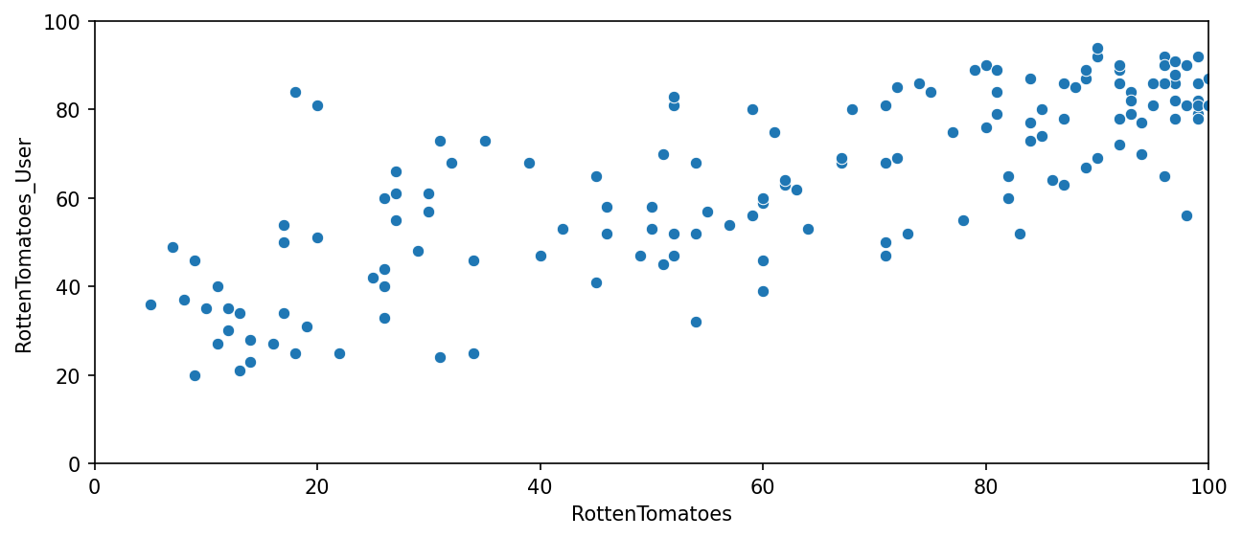
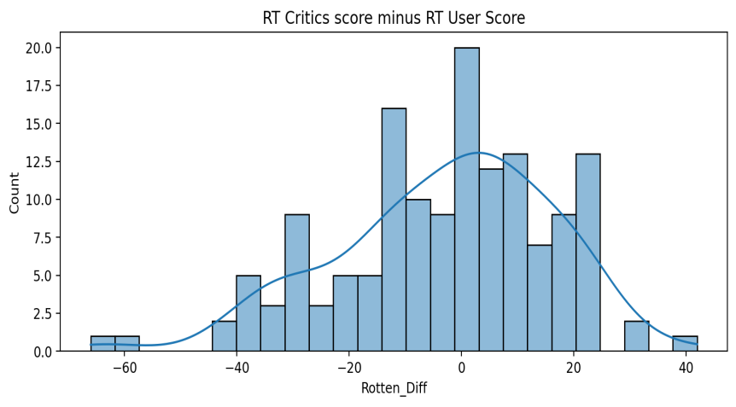
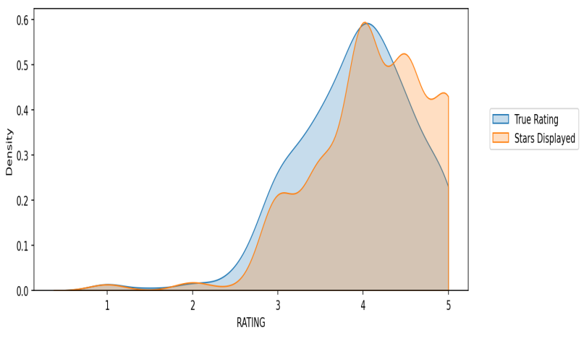
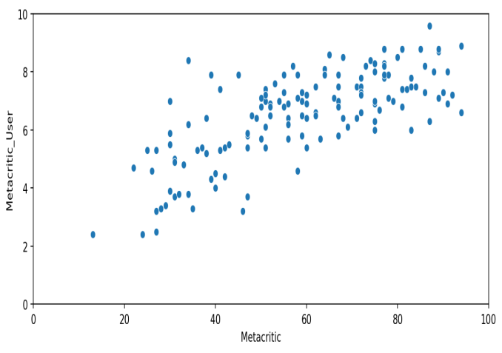
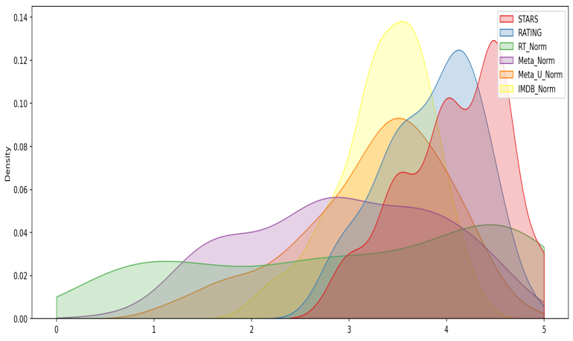
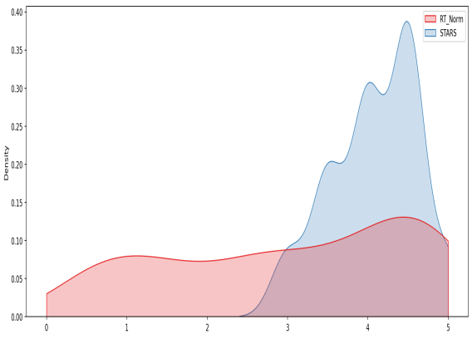
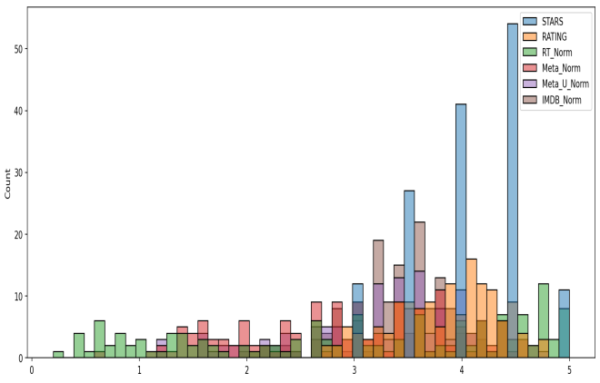
RESULT

Slide 12
CONCLUSION
The analysis revealed a noticeable discrepancy between Fandango's movie ratings and true user ratings. This suggests that Fandango's ratings may be inflated. The Python-based model developed during this project proved to be an effective tool for quantifying and visualizing these discrepancies. Future work could involve refining the model and incorporating additional data sources to enhance the accuracy of the discrepancy analysis.

Slide 13
FUTURE SCOPE
Expansion of Data Sources: Incorporate additional rating platforms like IMDb, Rotten Tomatoes, and Metacritic to provide a more comprehensive analysis.
Real-Time Analysis: Develop a system for real-time discrepancy analysis to give users current insights into rating trends.
User Demographic Analysis: Analyze how different demographics rate movies on Fandango versus their actual experience.
Predictive Modeling: Use machine learning to predict future discrepancies and identify patterns in rating behaviors.
Sentiment Analysis: Implement sentiment analysis on user reviews to correlate with the numerical ratings and discrepancies.
Mobile Application: Create a user-friendly app that alerts moviegoers about significant discrepancies before they make viewing choices.
Data Visualization: Enhance the presentation of data through interactive charts and graphs for easier interpretation of results.

Slide 14
REFERENCES
https://www.kaggle.com/datasets
https://pandas.pydata.org/
https://seaborn.pydata.org/
https://matplotlib.org/

Slide 15
THANK YOU

